Slide 1




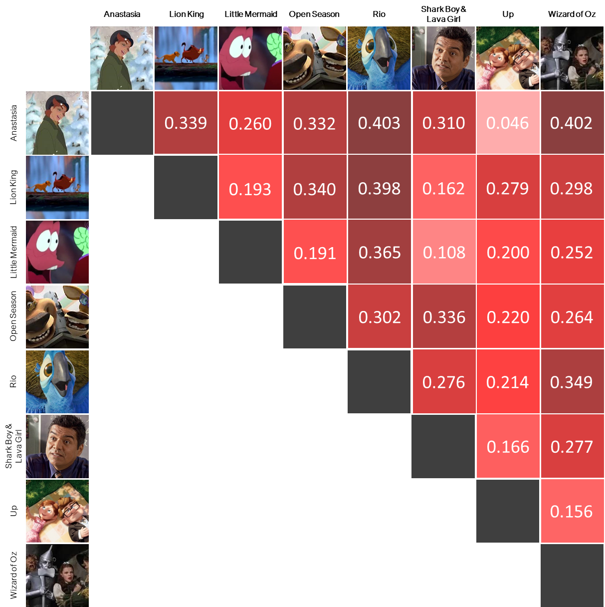
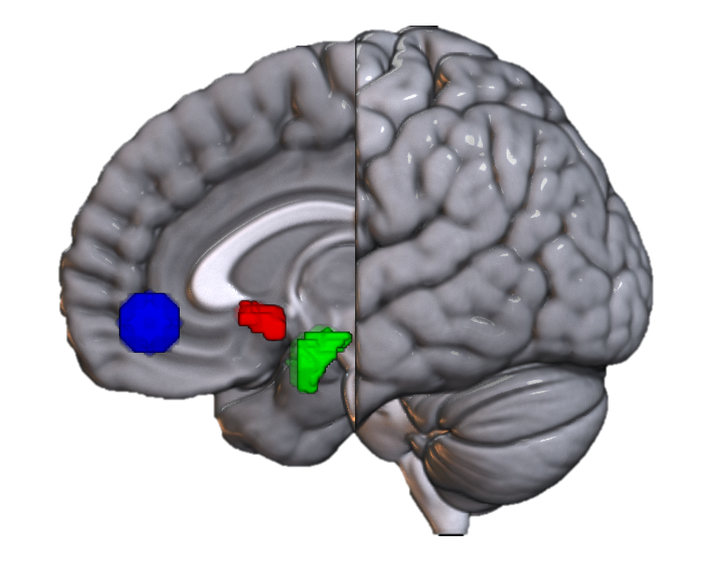
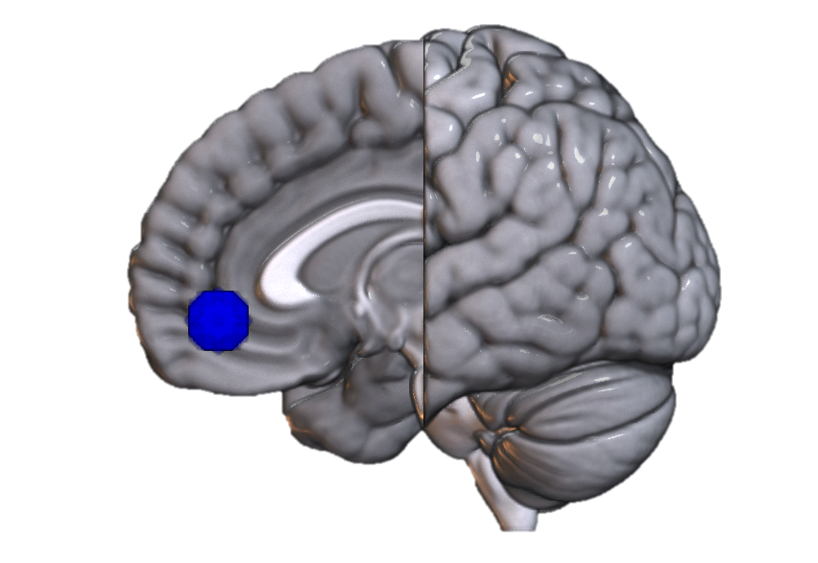


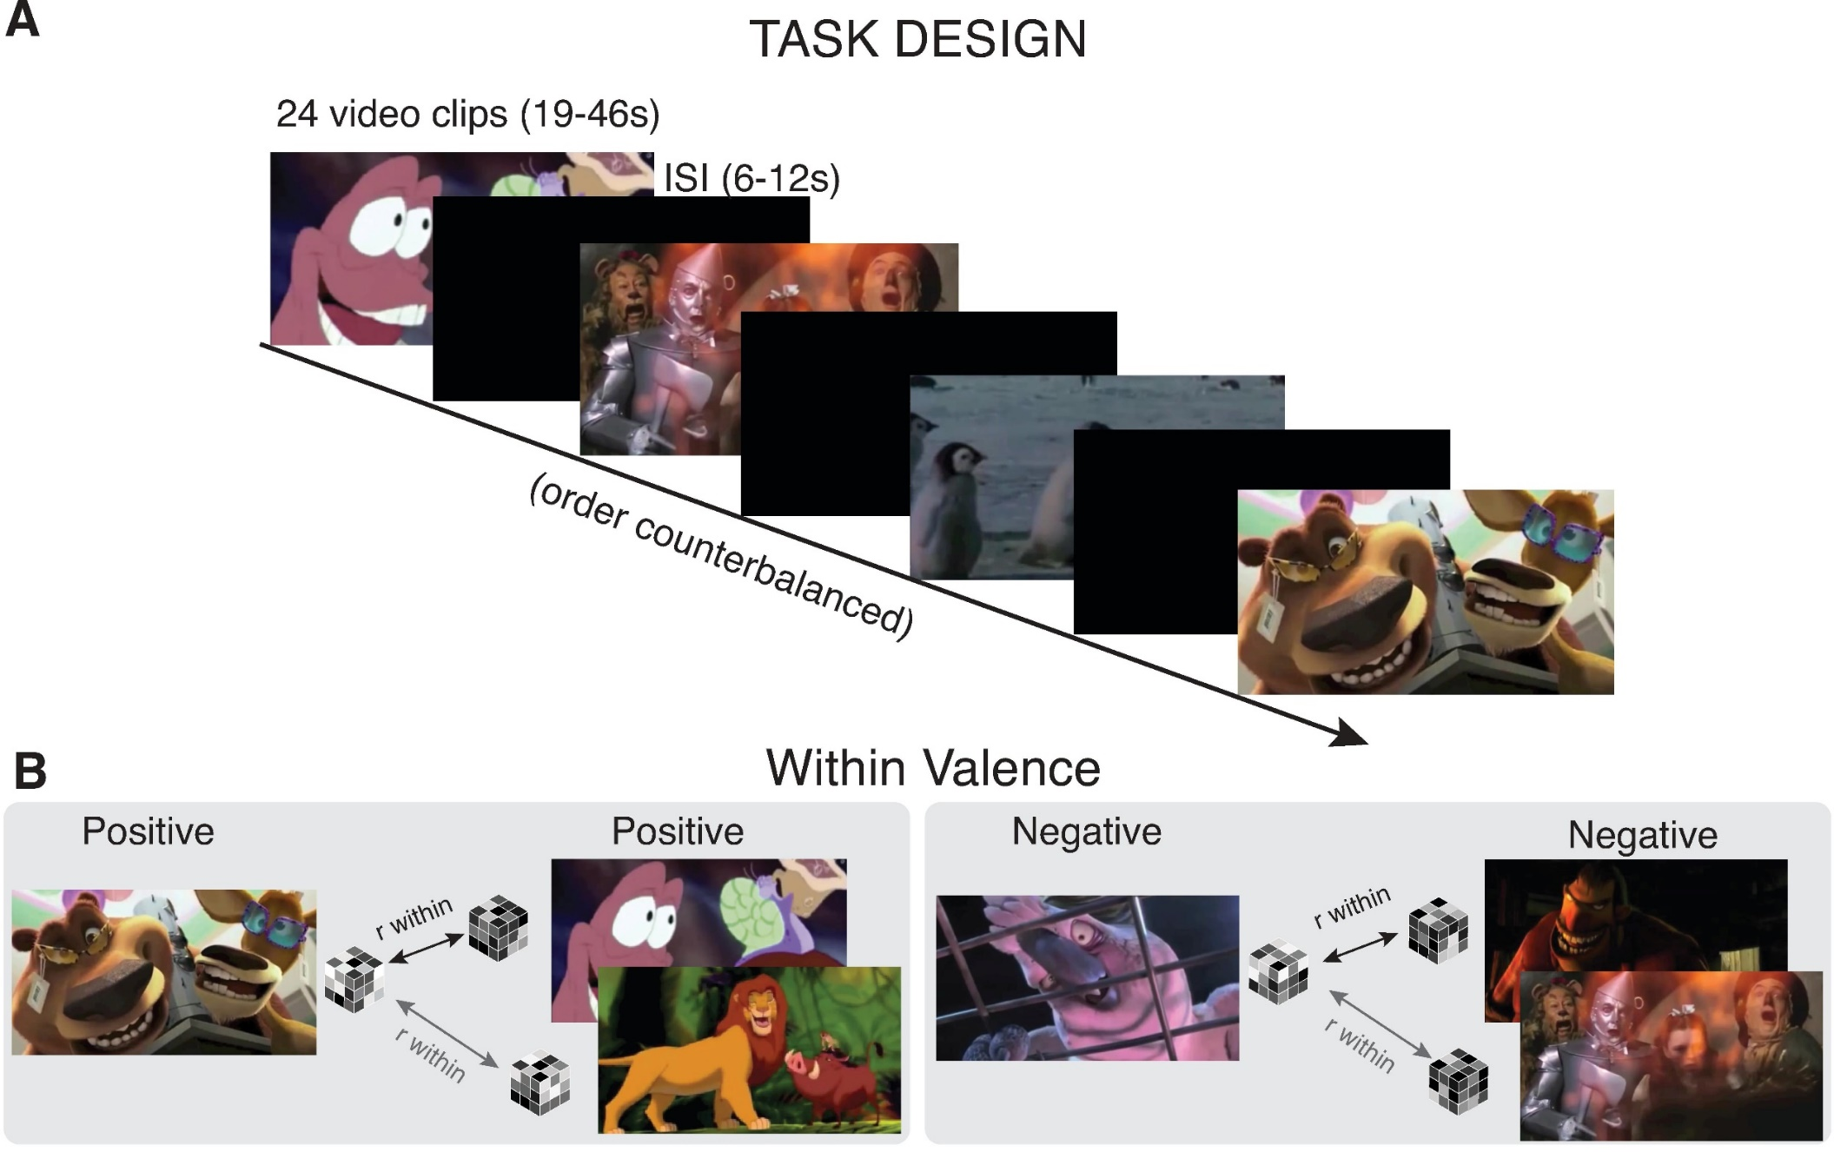

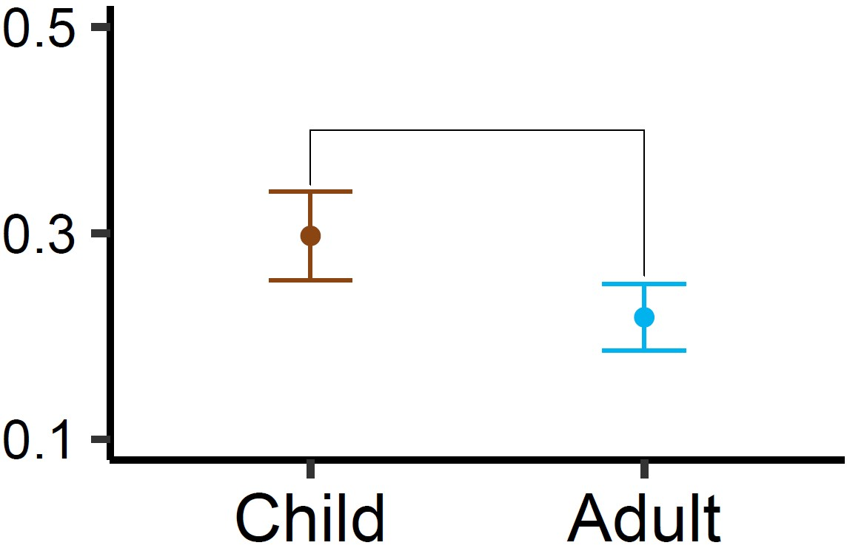
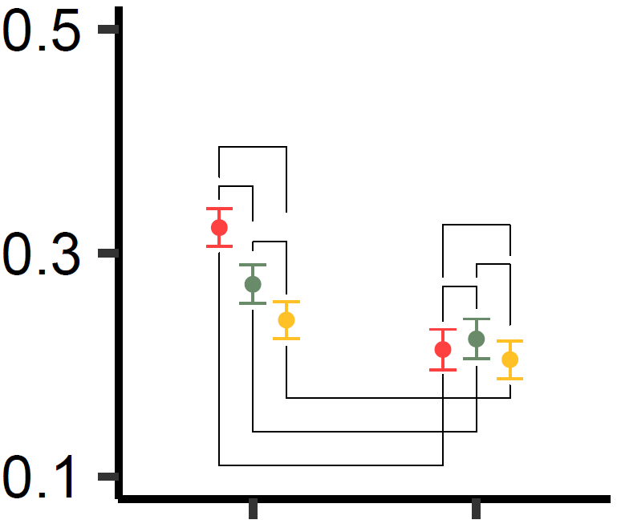
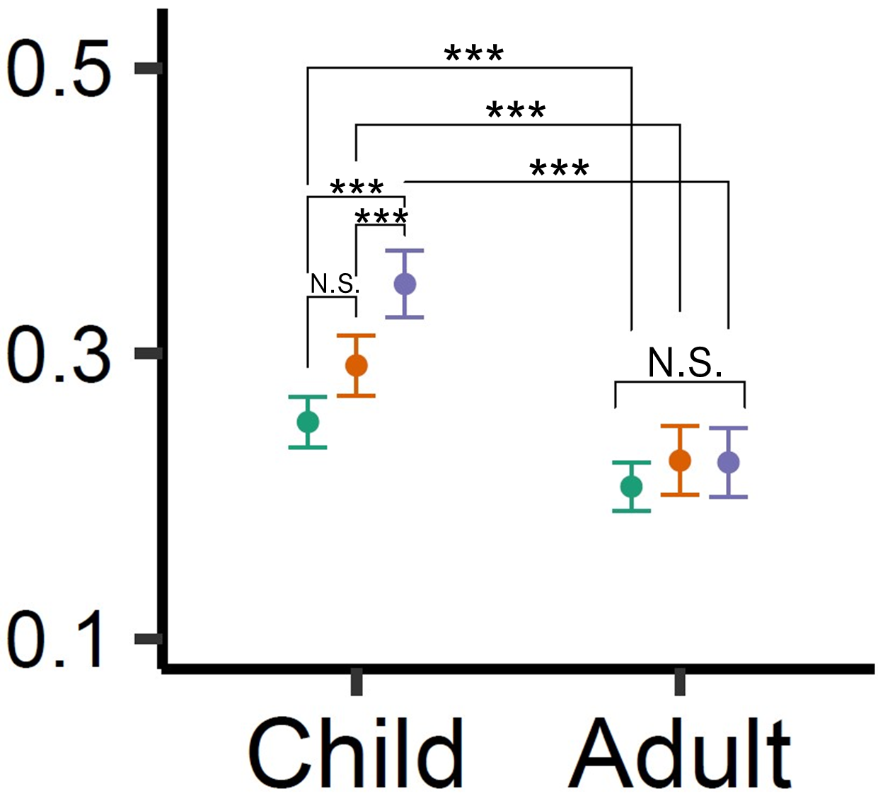
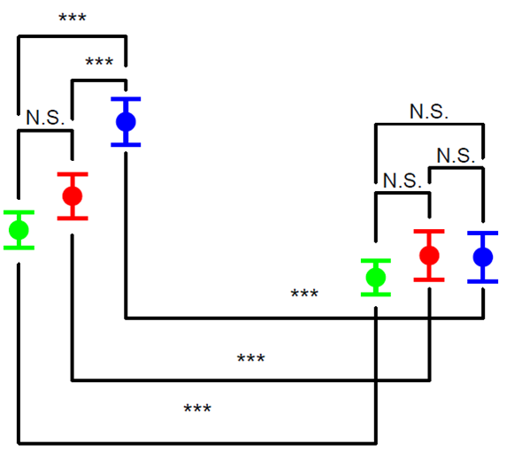
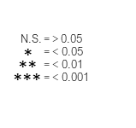
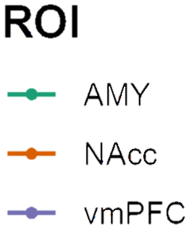







William Mitchell*, Lindsey Tepfer, Nicole Henninger, Susan Perlman, Vishnu Murty, Chelsea Helion
Do You Feel How I Feel?
Developmental Differences in Neural Representations of Affect
*Contact: Billy.Mitchell@temple.edu
Background
Hypotheses
Calculating RSA
Maturations in affective behavior correlate with network developments in key affective regions ¹⁻².
It’s unclear if these developmental differences are reflected within neural representations.
Naturalistic stimuli offer a more ecologically sound approach to exploring these developmental neural differences.
Children will generate more similar patterns than adults, suggesting less complexity
Children will generate more similar valenced patterns than adults, suggesting less differentiation
Child vmPFC patterns will be more similar relative to subcortical regions than adult patterns, suggesting greater recruitment in meaning-making tasks.
Each participants’ neural response patterns of the same valence and region were correlated. Matrices house the mean correlative values across participants of for stimuli pairs in any one ROI, which required the construction of 18 separate matrices. The average correlative value of a matrix the same age group symbolizes representational
Regions of Interest
Analyses
similarity of a valence type for one ROI and age group. Higher values suggest greater similarity. Mean values and variances can be analyzed in traditional ANOVA to measure representational pattern differences.
Sample
Intravalence pattern similarity was calculated using the Spearman’s rank method. Correlative values were transformed using Fisher’s Z.
Differences in mean pattern similarity were assessed using a 3 (ROI) x 3 (Valence) x 2 (Age Group) Mixed Effects ANOVA with Bonferroni-adjusted post-hoc contrasts.
Method
vmPFC
Children and adults passively watched 24 film clips (8 Pos, 8 Neg, 8 Neut) during an fMRI scan ³. The neural patterns evoked within the vmPFC, NAcc, and Amyg were analyzed using an RSA approach.
Amyg
NAcc
Results
COMPLEXITY
DIFFERENTIATION
MEANING-MAKING
Discussion
Children demonstrated greater pattern similarity overall
Children generated more similar patterns for positive and negative, but not neutral, stimuli
Children’s vmPFCs demonstrated greater pattern similarity than subcortical regions; adults did not
Results suggest neural affective representations demonstrate predictable patterns in line with known behavioral developmental differences.
Importantly, this research cannot comment upon the contents of representations, does not include adolescents, and has a relatively small sample size.
This is the first application of a representational similarity approach on a developmental population using naturalistic stimuli to document affective differences.
A
B
Valence Type
C
Region of Interest
Negative
Amyg
Positive
NAcc
Representational Similarity ⁴
*
Neutral
***
vmPFC
What is it? Watching film generates observable neural patterns. When stimuli with similar features elicit similar patterns, we learn about how those features are represented in the brain. Why does it matter? Behaviors and cognitions reference representations. Understanding normative representational development can inform our understanding of non-normative outcomes.
***
N.S.
N.S.
Mean Correlative Value (Fisher’s Z)^
N.S.
References
MANUSCRIPT
***
Nook, E. C., … & Somerville, L. H. (2017). Increasing verbal knowledge mediates development of multidimensional emotion representations. Nat. Human Behav., 1(12), 881–889.
Silvers, J. A., … & Ochsner, K. N. (2012). Age-related differences in emotional reactivity, regulation, and rejection sensitivity in adolescence. Emotion, 12(6), 1235–1247.
Karim, H. T., & Perlman, S. B. (2017). Neurodevelopmental maturation as a function of irritable temperament. Human Brain Map., 38(10), 5307–5321.
Popal, H. S., Wang, Y., & Olson, I. R. (2019). A Guide To Representational Similarity Analysis for Social Neuroscience. Social Cog. Affect. Neurosci., 14(11),1243–1253.
***
Child
Adult
Child
Adult
Child
Adult
^ Note: Full range (-1.77 to 1.76) of Y-Axis restricted in visuals for comprehension sake. Error bars represent 95% confidence intervals.
Notes:
Behavioral and cognitive studies suggest that children develop more complex conceptions of emotion and expressions of affectivity across normative development and into adulthood.
Between these periods there are a lot of changes in the connectivity and structure of regions
which might exhibit neuromodulatory effects relevant to affective experiences.
It may be the case that as these structures develop, how individuals represent affective information,
or the ways in which they mentally render charactistics of the concept, become more complex as well.
And this is relevant because representations may have an influence on downstream processes that affect future cognition and behavior.
To determine whether these differences in affective representations exist,
We’d asked 36 children and 21 adults to passively watch a custom stimuli set while undergoing an fMRI scan.
1 Adult and 11 children were excluded from the final dataset for excessive head motion
The stimuli set contained 8 positive and 8 negative clips from 8 popular children’s movies, such that each movie provided both a positive and negative clip.
8 Neutral clips were also sourced from various nature documentaries.
The order of clips were pseudo-randomized to one of three possible conditions.
All clips were normalized by luminosity.
Clips contained both animated and live action movies,
anthropomorphic and human characters
and spanned a long time period, with release dates from 1939 to 2011.
In terms of quality control: No group differences in familiarity were observed between adults and children.
Independent raters counter balanced clips on a second-by-second basis for affective intensity,
affective presence,
and presence of social stimuli.
We identified three regions relevant to our question:
the Amygdala,
the nucleus accumbens within the ventral striatum,
and the ventromedial prefrontal cortex.
And we chose these sites because The literature suggests all three should represent affective information
and may undergo structural and functional changes over normative development.
Additional details about our stimuli and pre-processing
are captured in the supplementary handout I’d included.
From each of our three regions, we’d captured patterns of changes in neural activation over subsequent stimuli presentations.
By correlating neural activation patterns across stimuli of the same valence and within the same ROI,
we can use a method called representational similarity analysis
to arrive at a value that symbolizes the strength of the representation of that valence for a particular region.
In other words, when a region produces a highly similar pattern
in response to different stimuli all holding one characteristic in common,
it can be inferred that the observed response is a product of that common characteristic.
Once we arrive at those values, which are essentially non-parametric correlations,
one could spatially analyze the correlation matrix they’d produced,
or refer to a more traditional analysis of variance.
So with that in mind, we hypothesized that adults would generate less pattern similarity than children,
and this is based on the theory that they’ll entertain more complex conceptions of emotion.
We also hypothesized that children would generate a greater difference between positive and negative pattern similarity than adults.
Lastly, because of the profound developmental changes associated with the vmPFC relative to subcortical structures,
we hypothesized the interaction between subcortical structures and the vmPFC
would produce greater variance in representational pattern similarity for children relative to adults.
After computing our RSA values using a Spearman Rank Correlation and applying a Fisher’s Z transformation,
our values were entered into a 3 x 3 x 2 Mixed Effects ANOVA,
with terms for ROI, Valence, Age Group, and interactions among them.
Additional contrasts were pursued post-hoc and Bonferroni-adjusted.
Prior to pursuing our primary analysis, we explored the coherence of our child grouping.
We did this by entering age as a predictor towards pattern similarity in a mixed effects linear regression model
We found no relationship among children by age,
suggesting no reason for us to treat the values we observe from a child at age 4 and differently than we would a child at age 10.
In all cases for our primary analyses, we supported our hypotheses.
Children did demonstrate greater pattern similarity relative to adults.
Children also demonstrated greater negative pattern similarity relative to positive pattern similarity; an effect which was not mirrored in their older counterparts.
Children also demonstrated greater affective pattern similarity relative to our neutral control, while adults did not seem to differentiate along affective lines.
Lastly, adults demonstrated no ROI differences while children demonstrated differences between the vmPFC and each subcortical structure.
All in all, these results do suggest that differences in affective representation exist between adults and children.
Being put in the context of the extant research, this may reflect a maturation from visceral affective responses to more evaluative processes.
However, given these analyses, we cannot speak with any certainty as to exactly what about these representations are similar,
what mechanisms might contribute to a change in representation,
and whether these representations do have any meaningful impact on behavior.
Futures analyses should explore these relationships.

